Slide 1


COMPUTER ORGANIZATION AND ARCHITECTURE
CLOSELY COUPLED AND LOOSELY COUPLE MULTIPROCESSORS
GUIDED BY : Bharti Patel
Here starts the lesson!
PRESENTED BY : Anjali Patel

Slide 2
Contents
INTRODUCTION
HOW MULTIPROCESSOR ARE CLASSIFIED?
DIFFERENCE BETWEEN CLOSELY COUPLED AND LOOSELY COUPLED MULTIPROCESSOR .

Slide 3

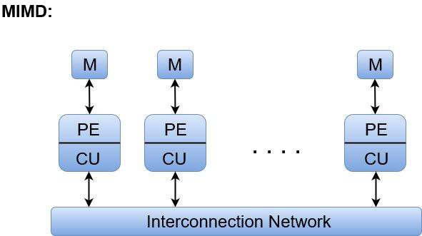
INTRODUCTION
01
cpu
1. MULTIPROCESSOR System is an interconnection of two or more CPUs with memory and input-output equipment.
2.A multiprocessing system is used to increase overall system performance in work being accomplished, also referred to as throughput.
cpu
Shared memory
cpu
3.Multiprocessors are classified as multiple instruction stream,multiple data stream(MIMD) system.
4.All processors in a parallel computer can execute different instructions and operate on various data at the same time. In MIMD, each processor has a separate program and an instruction stream is generated from each program.
cpu
MULTIPROCESSOR
5. By working together problems can be divided up among processor for faster completion, also called "divide and conqueror“.
M:memory,PE:processing element,CU:control unit

Slide 4
* Multiprocessors are classified by the way their memory is organised , mainly it is classified into two types: 1. Closely (Tightly) coupled multiprocessor 2. Loosely coupled multiprocessor
02
HOW MULTIPROCESSOR ARE CLASSIFIED?

Slide 5
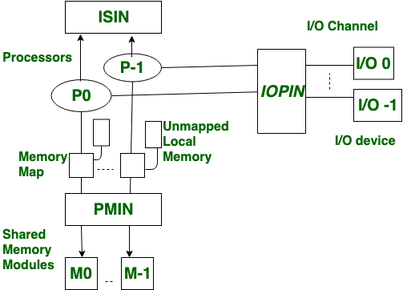
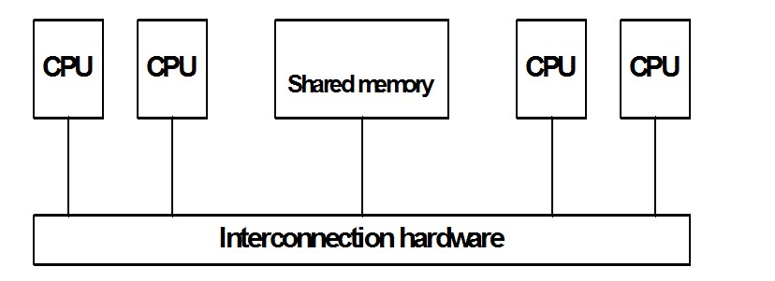
CLOSELY (TIGHTLY) COUPLED MULTIPROCESSOR
Closely coupled multiprocessor
* A multiprocessor is a tightly coupled computer system having two or more processing units (Multiple Processors) each sharing main memory , in order to simultaneously process programs.
* Also known as shared memory system.
PMIN : processor- memory interconnection network
IOPIN : input output processor interconnection network
ISIN : interrupt-signal interconnection network
The MPIN is a switch , used to connect every processor to memory.
The IOPIN is used to allow the processor to communicate with an I/O channel which is connected to I/O devices.
The ISIN is used for purpose : to direct an interrupt to any other inter processor network and to initiate hardware alarm in case of processor failure.

Slide 6
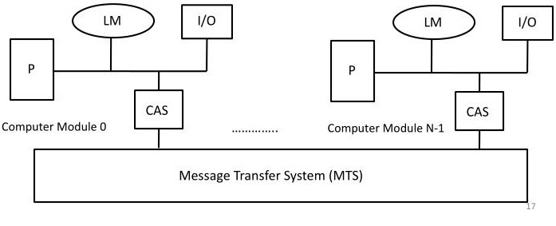
LOOSELY-COUPLED MULTIPROCESSOR
LOOSELY-COUPLED MULTIPROCESSOR
* Loosely-coupled multiprocessor systems (often referred to as cluster)are based on multiple standalone single or dual processor commodity computers interconnected via a high speed communication system.
* Also known as distributed memory.
ADVANTAGES :
Better system throughput
Parallel processing
More flexible
More reliable
LM : local memory
CAS : channel arbiter switch
P : processor

Slide 7
D
03
DIFFERENCE B/W TIGHTLY COUPLED AND LOOSELY COUPLED MULTIPROCESSOR
DIFFERENCE B/W CLOSELY COUPLED AND LOOSELY COUPLED
TIGHTLY COUPLED MULTIPROCESSOR | LOOSELY COUPLED MULTIPROCESSOR
1.Tightly couple multi processors has shared memory. | 1. Loosely couple multi processors has distributed memory.
2. The degree of coupling between processors is high. | 2. The degree of coupling between processors is low.
3. In tightly couple multi processor CPU's connected in close communication. | 3. In losing multiprocessor CPU / systems located at different locations.
4. In this system CPU share output bus memory and input output devices. | 4. In this system there is no such sharing.
5. It is efficient when high degree of interaction between processes and for High speed and real time processing. | 5. It is efficient when task running on different processors has minimum interaction between them ( parallel application).
6. Memory conflict occurs due to use of share memory. | 6. No memory conflict occurs.
7. Processors communicate with each other using shared memory. | 7. Processors communicate with each other by using message passing techniques.
8. Data rate is high. | 8. Data rate is low.
9. More expensive. | 9. Less expensive.
10. Compact in size. | 10. Larger in size.
11. Let's scalable limited number of CPU's can be added. | 11. Celebrities high more number of CPU can be added to improve the system performance.
12. Less fall tolerant if shared memory corrupted then causing all processors to fail. | 12. More fault tolerance A fault in a single system module does not lead to a complete system breakdown.
13.Less complex. | 13. Complex due to additional hardware is required to provide communication between the individual processors.
14. Portable. | 14. Less portable.
04

Slide 8



THANK YOU !

